Slide 1
Time Series Analytics for Big Fast Data
Milwaukee Meetup
Rachael Moore – Global Business Development Executive
Killian Daly – Data Scientist

Slide 2
About Kx
Founded in 1993
Subsidiary of First Derivatives Plc (LON:FDP)
2,000+ employees
Global presence

Slide 3



























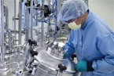




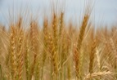

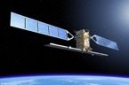
Customers & Partners

Slide 4
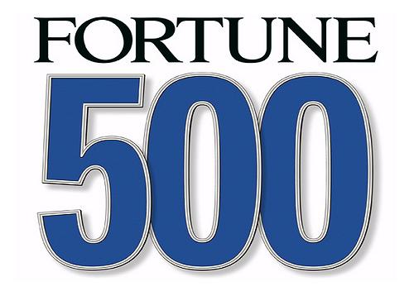

OTHER VERTICALS
Health & Life Sciences
Space and Telco
Genomics Data Processing
Connected Health
Patient Record Analytics
Earth Observation
Geospatial Data Analytics
Anomaly Detection
Retail
Automotive
Retail Analytics
Marketing Optimization
Customer Journey
Telemetry Analytics
Anomaly Detection
Performance Analytics
Manufacturing
Utilities
Sensor Analytics
Smart Meters Data
Predictive Analytics
Edge Computing
Multivariate Analysis
Fault Detection

Slide 5
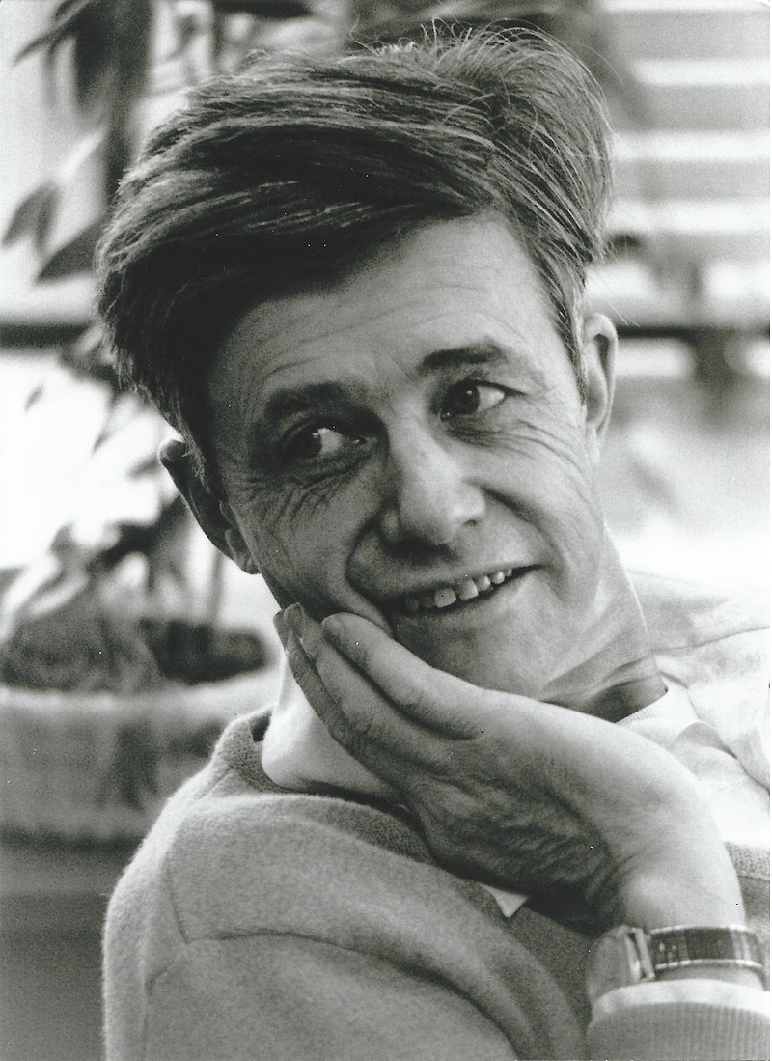

Slide 6


Slide 7
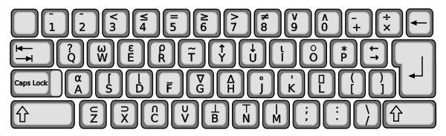

Slide 8
(~R∊R∘.×R)/R←1↓ιR

Slide 9


Slide 10
2_&{&/x!/:2_!x}'!R

Slide 11
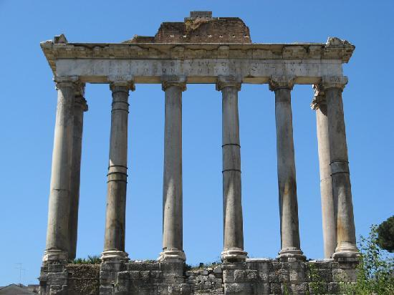

Slide 13
kdb+
Unified columnar database & programming system
Lambda architecture
Streaming
Real-Time (In-Memory)
Historical (On-Disk)
In-database analytics
Support for joins
500 kB binary

Slide 14
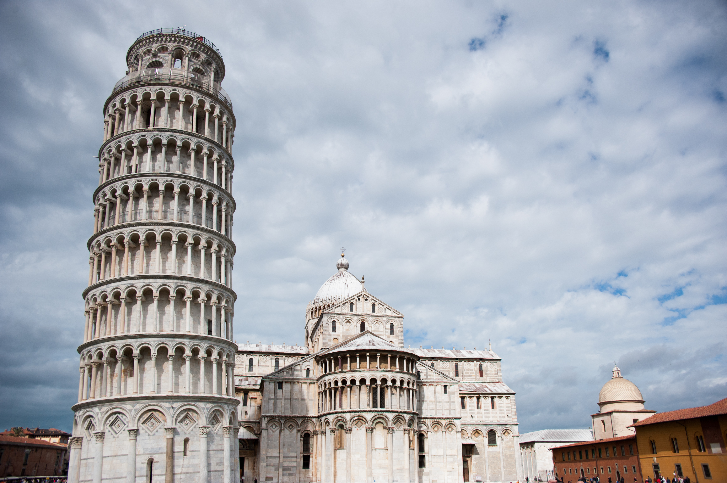

Slide 15
Typical kdb+ Architecture
Stream/
Complex Event Processing

Slide 16


Slide 17
Database Data Types
Boolean
Byte
Integer (short/int/long)
Floating Point (real/float)
Character
Symbol (interned character)
GUID
Enumeration
Dictionaries
(Keyed) Tables
Functions

Slide 18
Time Series data types
Date
Time
Minute
Second
Month
Datetime
Timespan (ns)
Timestamp (ns)

Slide 19


Slide 20
q programming language
Functional
Array/Vector
Query
Interpreted

Slide 21
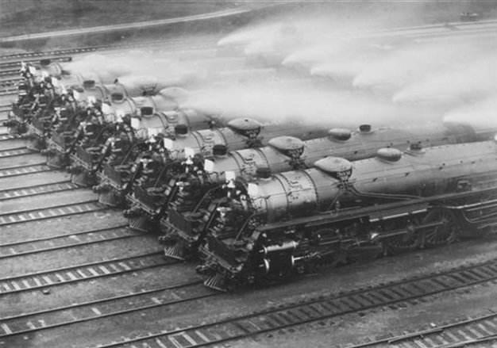

Slide 22
Parallelism
Vertical Scaling
Multi-threading
No serialization
Automatically distributes queries across CPU cores
Horizontal Scaling
Multi-processing
Automatically distributes queries across machines
Exploits Intel vector instruction sets
Native Map-Reduce

Slide 23


Slide 24
Compression
WebSocket compression
In-flight compression between hosts
On-disk compression
kdb+ algorithm
gzip
Google Snappy
lzh4c

Slide 25
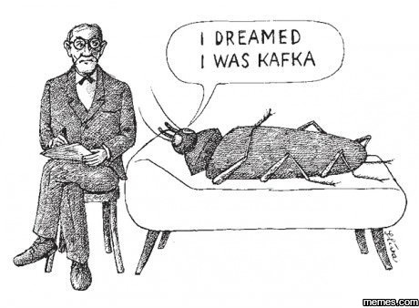

Slide 26
Enterprise Interfaces
Kafka
R & Matlab
C/C++
Python &
Perl
ODBC/
JDBC
Web
Services
Java/Scala
TCP Sockets
& Web
Sockets
C#/.NET
CDC

Slide 27


Slide 28



Kx Performance Snippets
Process & store
4.5 million events/second/core
500 KB profile (L1/L2 Cache)
Ingest data at 10 million records/
second/core
Search in-memory tables at 4 billion records/
second/core
Streaming
1.6 TB
of Data Daily
Trusted by 17/20 World’s Top Investment Banks

Slide 29
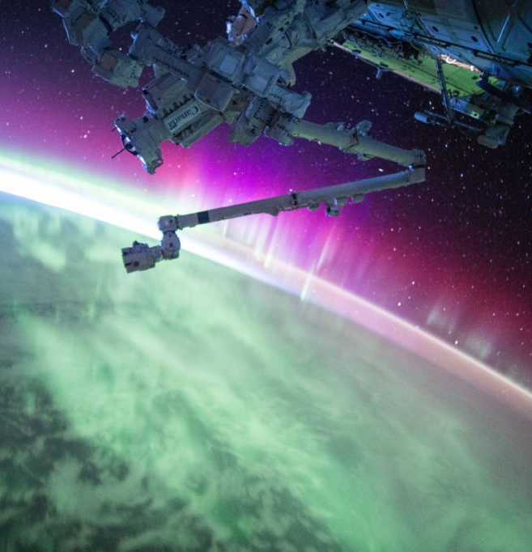

NASA and NYC Motor Vehicle Demo with Killian Daly
The NASA MERRA-2 data is available at: https://disc.sci.gsfc.nasa.gov/uui/datasets?keywords=%22MERRA-2%22.
Roughly 250TB of data
Data divided across 100 datasets
Measurements from world-wide grid points from 1980-2016
.nc4 (Network Common Data) file type

Slide 30

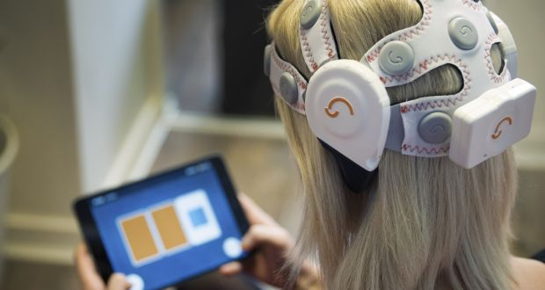


Kx selected by BrainWaveBank as the platform for the world’s first Big Data collection of brainwave activity

Slide 31

Kx powers Data Mart for Ontario’s Smart Meter Data

Slide 32
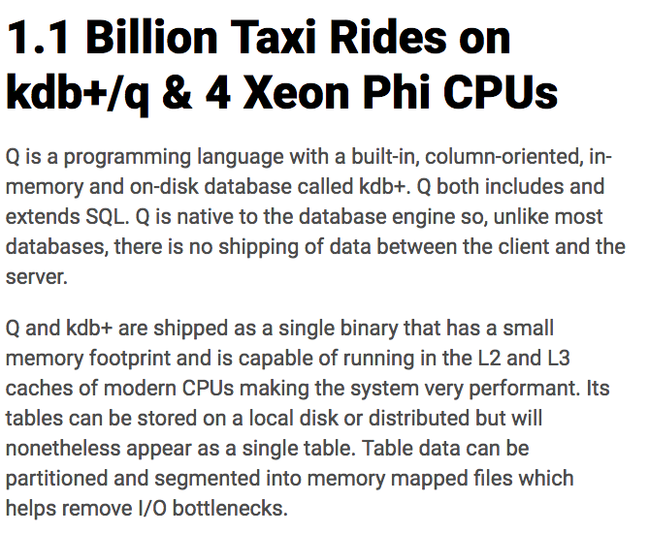

Resources - Benchmarks

Slide 33
Additional Resources

Slide 34
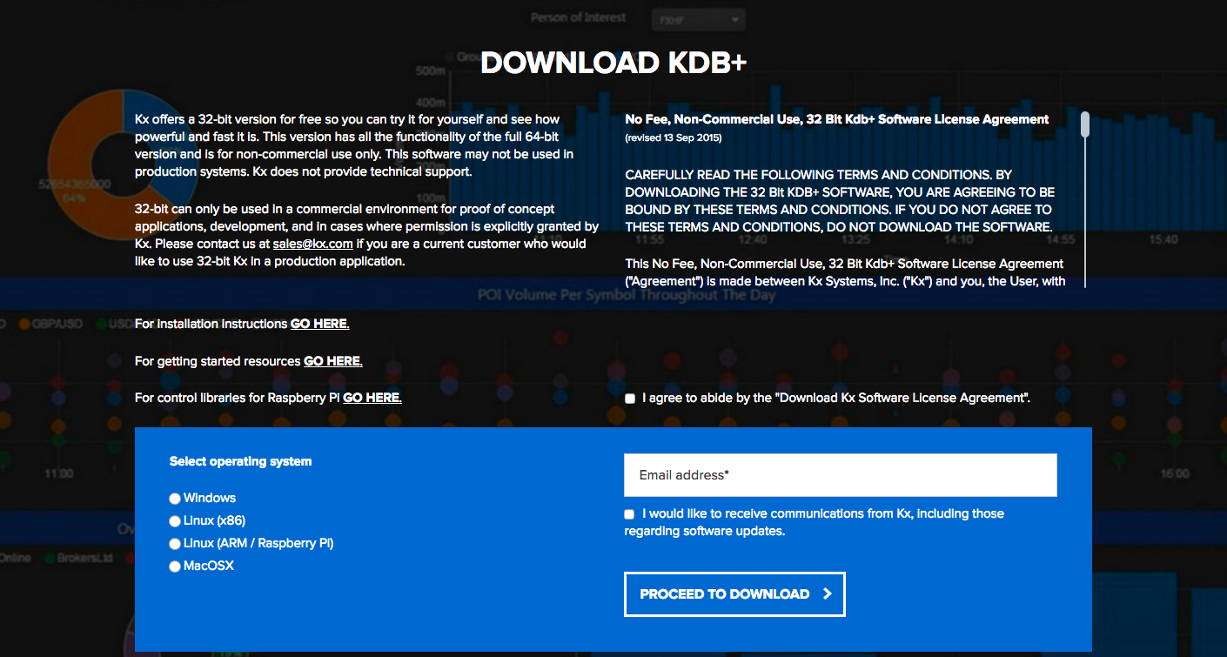
Resources - Free version

Slide 35
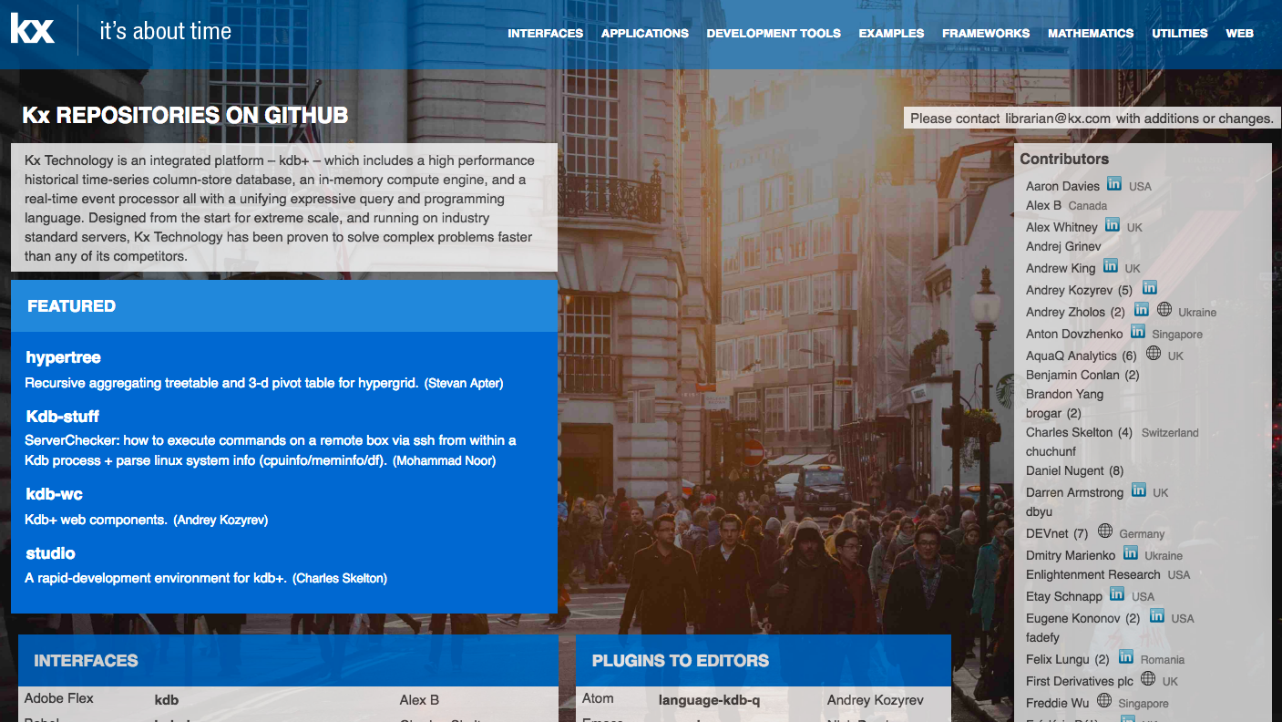
Resources – Github Repository

Slide 36
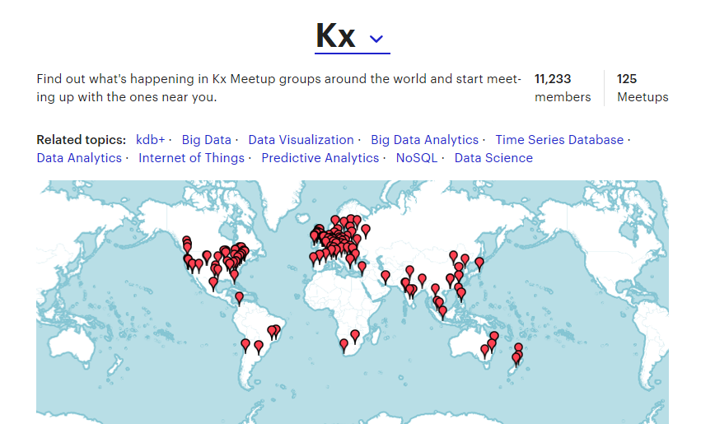
Resources – Meetups

Slide 37


Resources – Books

Slide 38


Kx TECHNOLOGY FUND
£10 Mil Funding
Kx Tech Access
Int. Office Access
Sales & Marketing Support
Logistical Support
Learn more at www.kx.com/kx-technology-fund/

Slide 39
Recruitment
Opportunities to travel and live internationally
Paid for city accommodation
Competitive salary and expenses package
Health and travel insurance programme
Generous retirement savings programme
Interested in joining us or know someone who might be?
Talk to me at the end or visit
www.firstderivatives.com/careers

Slide 40
Thank You
@KxSystems
https://kx.com/
https://kx.com/download/
Rachael Moore: rmoore@kx.com
Killian Daly: kdaly@firstderivatives.com

